Slide 1
PREDICTION IN E-COMMERCE WEBSITE
Prepare by
A. MYTHILI
V. SWETHA
K. SONIYA VAISHNAVI

Slide 2
Dataset Overview
- Total Entries: 9,999
- Columns: 16
- Key Attributes: InvoiceNo, Product, Quantity, Price, Sales Date, Country
- Objective: Analyze trends & forecast future sales

Slide 3
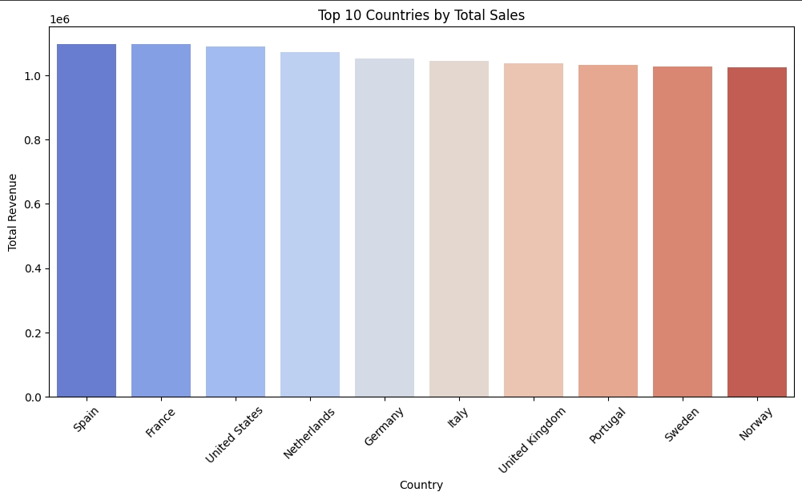
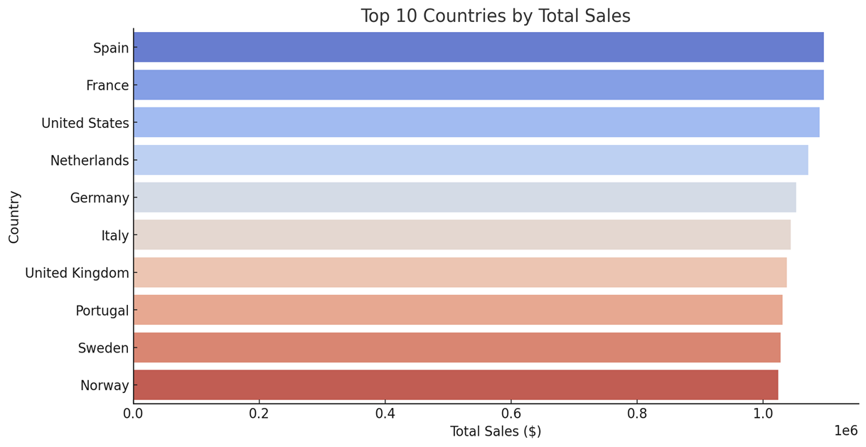
Top 10 Countries By Total Sales
Grouped sales by country and sorted by total revenue
Displayed as a bar plot using seaborn

Slide 4
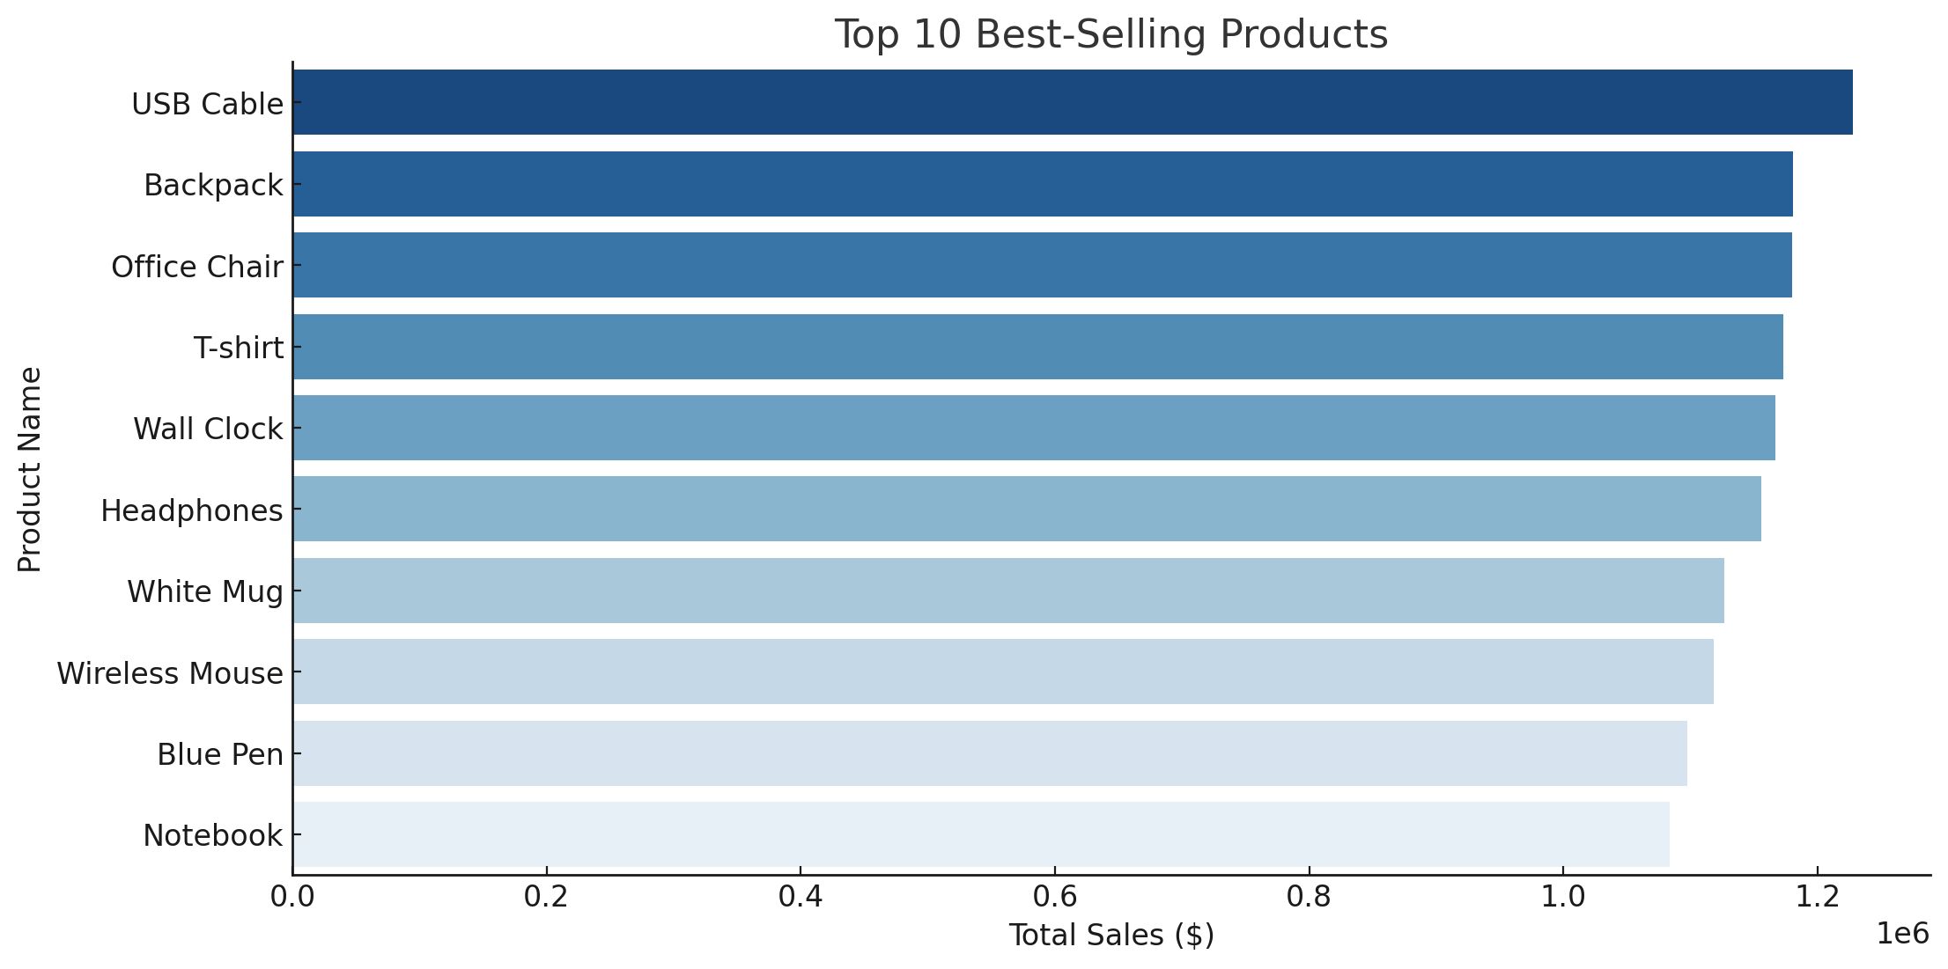
Top 10 Best-Selling Products
Backpack - 23,525 units
Office Chair - 23,364 units
USB Cable - 23,316 units
T-shirt - 23,240 units
Headphones - 23,178 units
Wireless Mouse - 22,459 units
White Mug - 22,284 units
Blue Pen - 22,053 units
Desk Lamp - 21,909 units
Wall Clock - 23,989 units

Slide 5
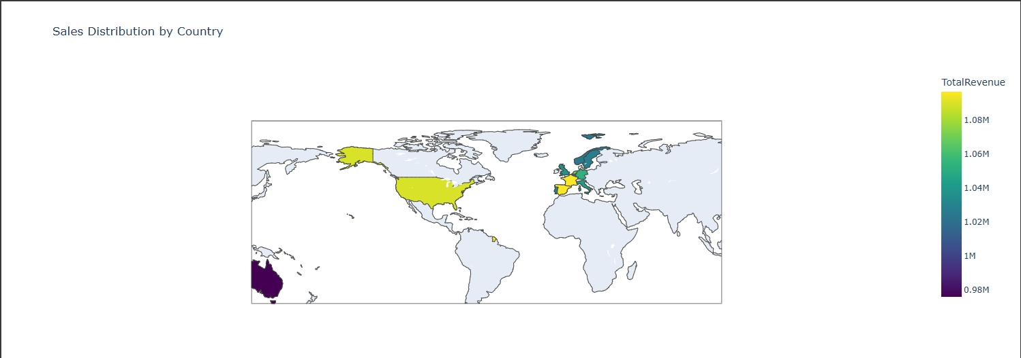
Sales Distribution By Country
Used Seaborn to plot a histogram with KDE
Helps visualize the frequency distribution of sales amounts

Slide 6
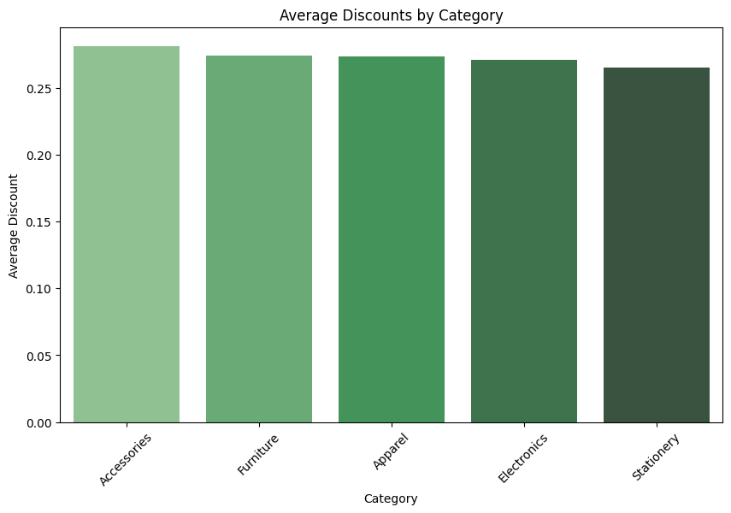
Average Discount By Category
Calculate the discount for each item: Discount = Original Price - Discounted Price
Group by category: Group the data by the category of the items.
Calculate the average discount for each category: Average Discount = Sum of Discounts in Category / Number of Items in Category

Slide 7
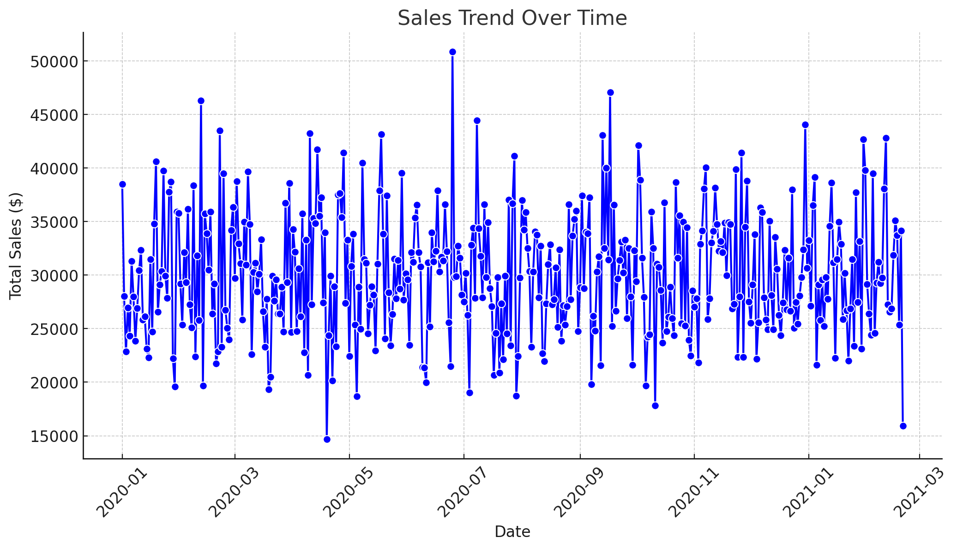
Sales Trend Over Time
Converted InvoiceDate to datetime format
Aggregated total sales by date
Line plot showing sales trend over time

Slide 8
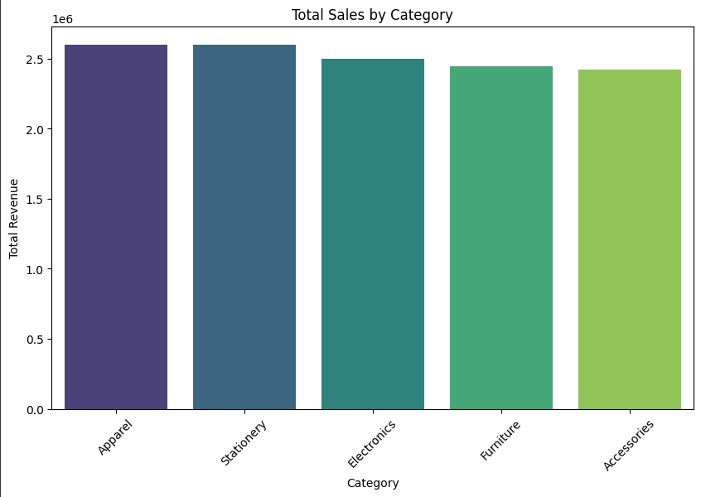
Total Sales by category
Apparel - $2,601,748.66
Stationery - $2,598,255.26
Electronics - $2,499,471.00
Furniture - $2,445,345.10
Accessories - $2,422,777.50

Slide 9
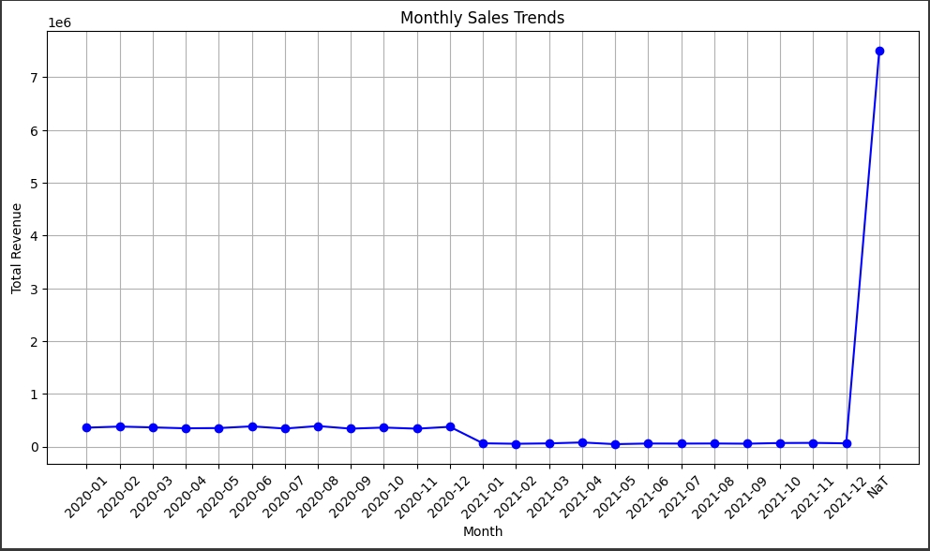
Monthly Sales Trends
Highest sales: November 2020 ($956,631.79)
Lowest sales: February 2021 ($601,176.21)

Slide 10
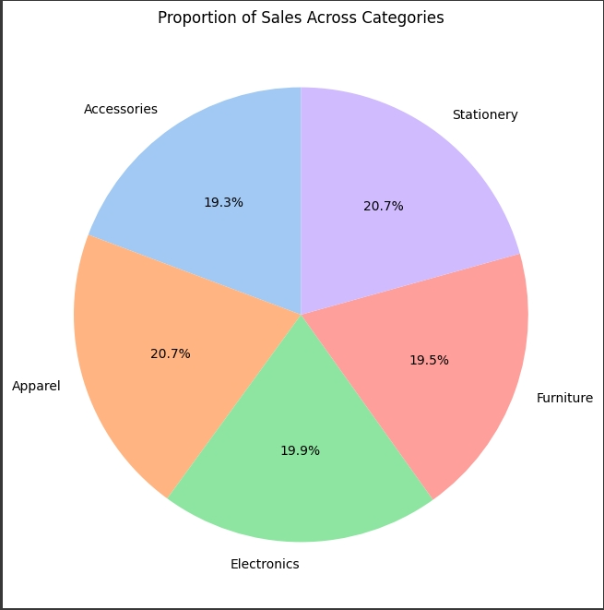
Proportion OF Sales Across Categories
Profit (Revenue - Cost) across categories?
Profit=Total Sales−Cost

Slide 11
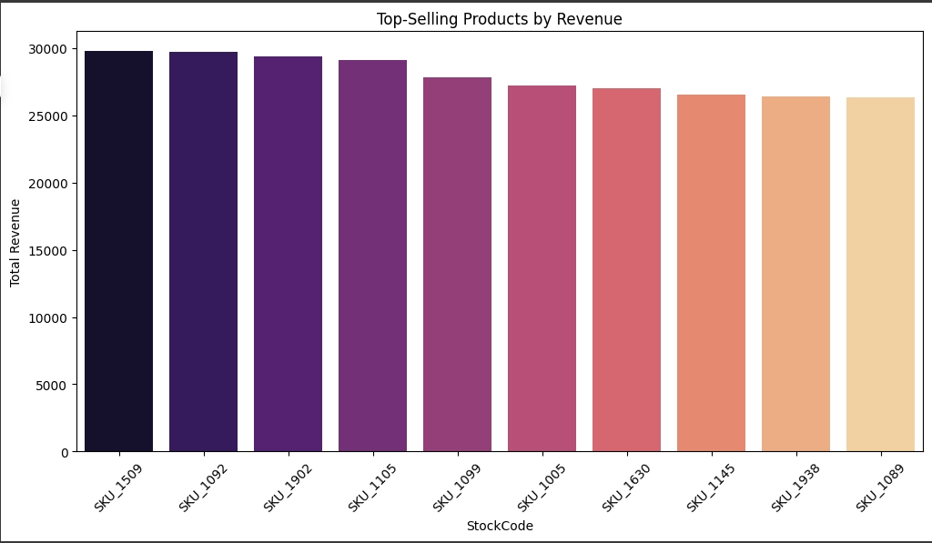
Top Selling Production by Revenue
USB Cable - $1,227,663.46
Backpack - $1,181,027.19
Office Chair - $1,179,853.04
T-shirt - $1,173,118.08
Wall Clock - $1,166,947.80
Headphones - $1,155,542.82
White Mug - $1,127,042.80
Wireless Mouse - $1,118,628.36
Blue Pen - $1,097,637.96
Notebook - $1,083,784.78

Slide 12
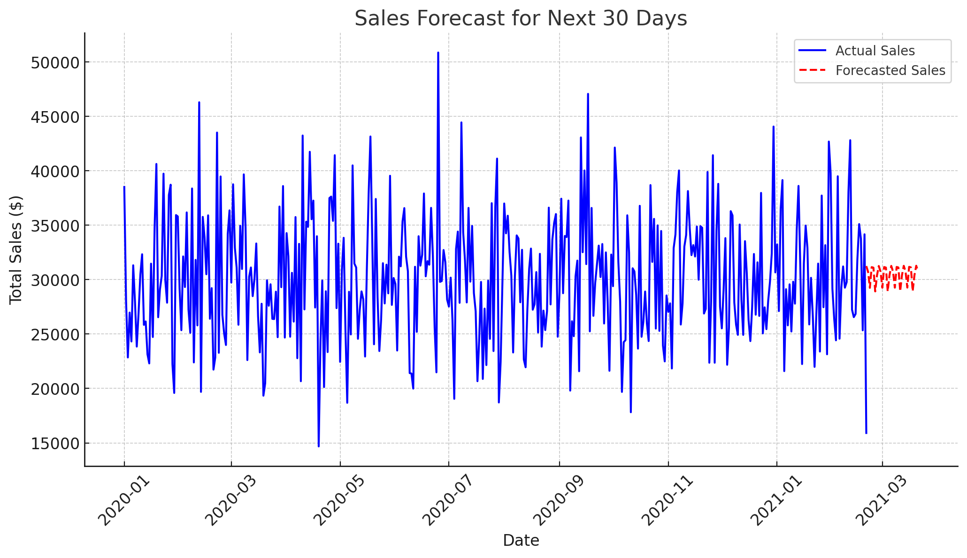
Sales Forecast for Next 30 Days
Expected daily sales range: ~$27,800 to ~$32,800
Peak forecasted sales: March 13, 2021 ($32,761.46)
Lowest forecasted sales: March 20, 2021 ($27,840.57)

Slide 13
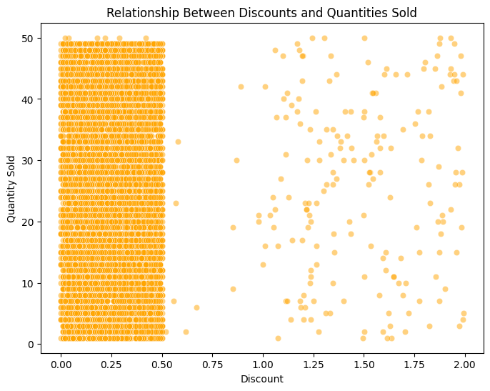
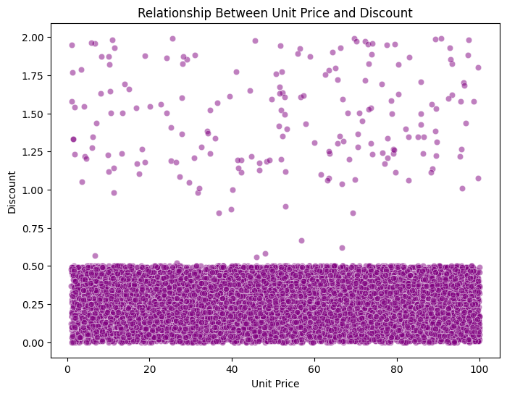
Relationship
Unit price and Discount
Discount and Quantity sold

Slide 14
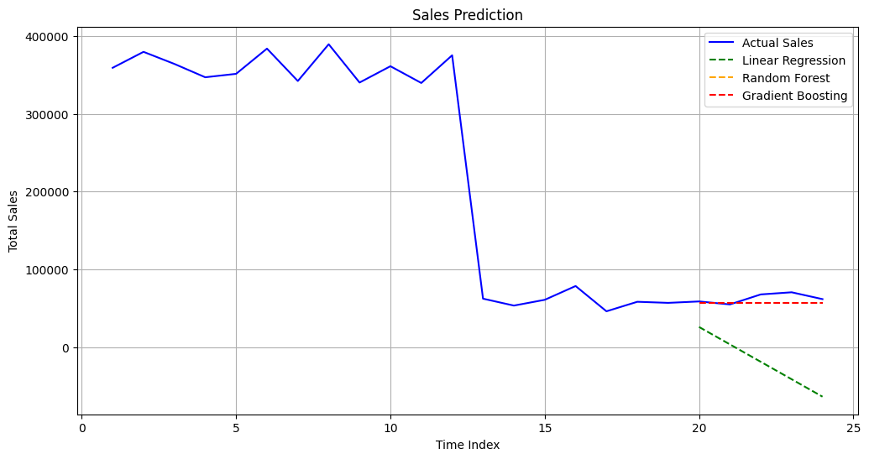
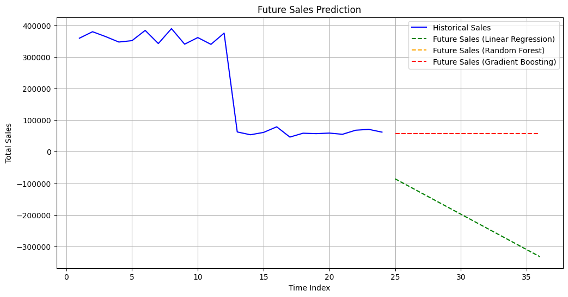
Comparision
Sales Prediction
Future Sales Analysis

Slide 15
Conclusion
- Sales trends indicate seasonal fluctuations
- Top products and best-performing regions identified
- Forecast predicts upcoming sales trends
- Businesses can use these insights for decision-making

